Slide 1

Artificial Intelligence & Decision Systems
22.05.2024

Slide 2

Agenda
Overfitting in DNNs
Exercise
Introduction to CNNs
Layers of CNNs
Exercise

Slide 3
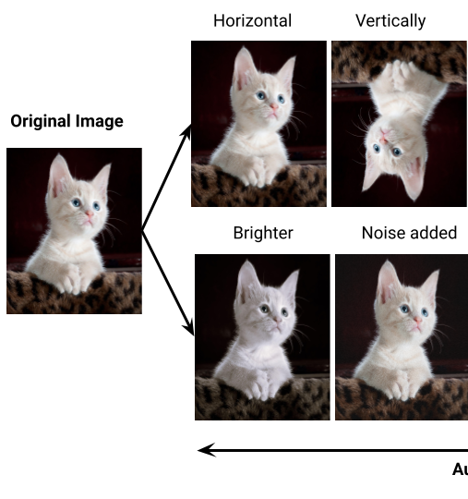
Preventing overfitting
Data Augmentation:
Geometric transformations
Color space transformations
Filters
Random erasing
Mixing

Slide 4
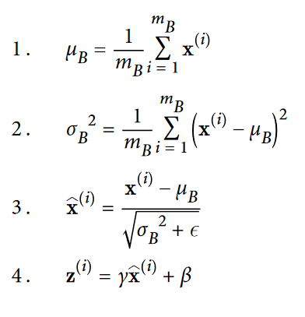
Preventing overfitting
Cross-Validation
Normalizarion:
Batch Normalization
Regularizarion:
Dropout
Early Stopping

Slide 5
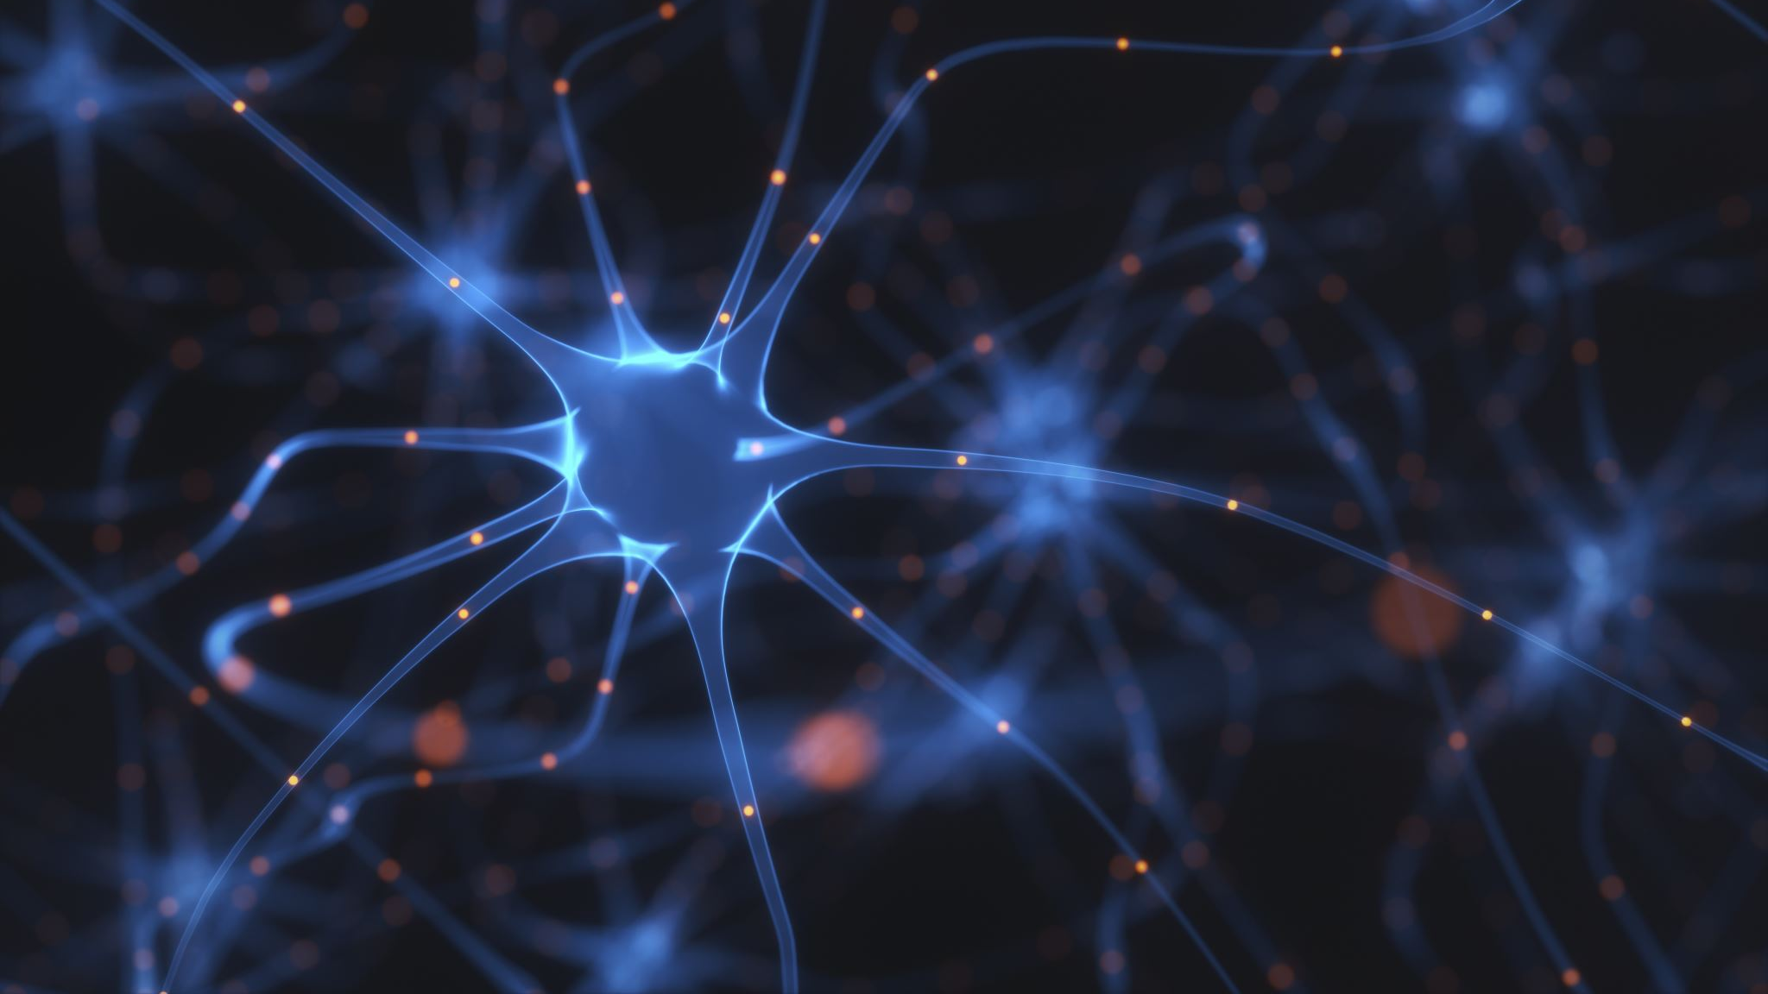
Convolutional Neural Networks

Slide 6

Application of CNNs
Image analysis
Video analysis
Image Generation
Autonomous systems
Computer Vision
NLP
Text Generation

Slide 7
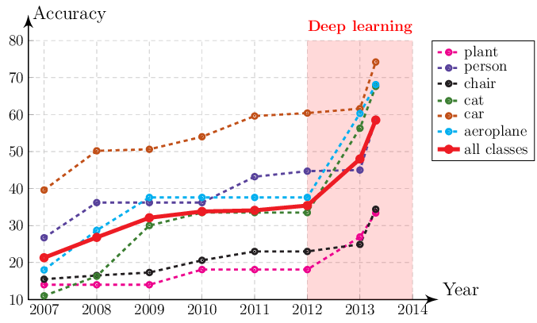
Background
Deep Learning model training on GPUs (2009)
ImageNet dataset (2010)
AlexNet (2012)
Accuracy of the best performing method on the PASCAL VOC 2007 Object Detection dataset

Slide 8
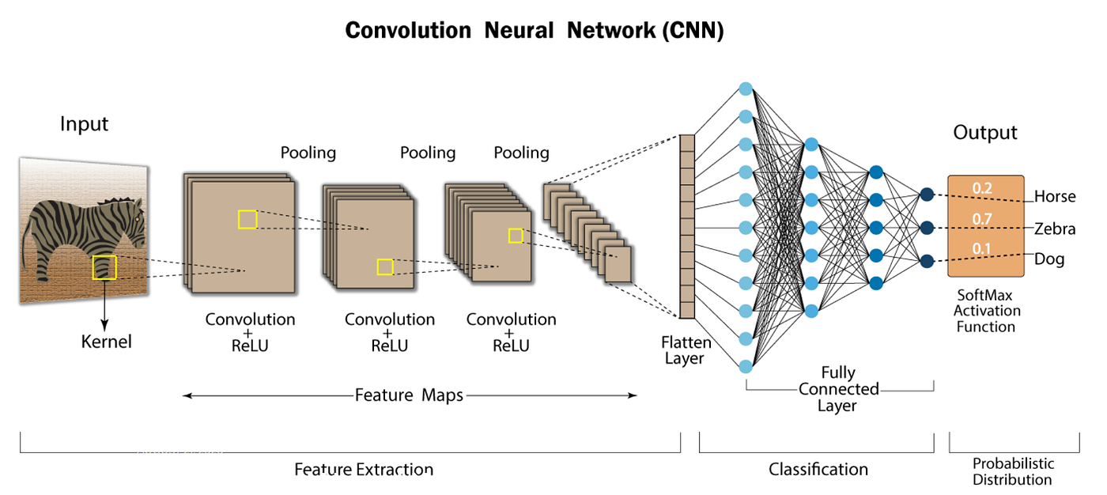
CNNs architecture

Slide 9

Input
Size:
Height
Width
Channels
Channels:
Gray -> 1
RGB -> 3

Slide 10
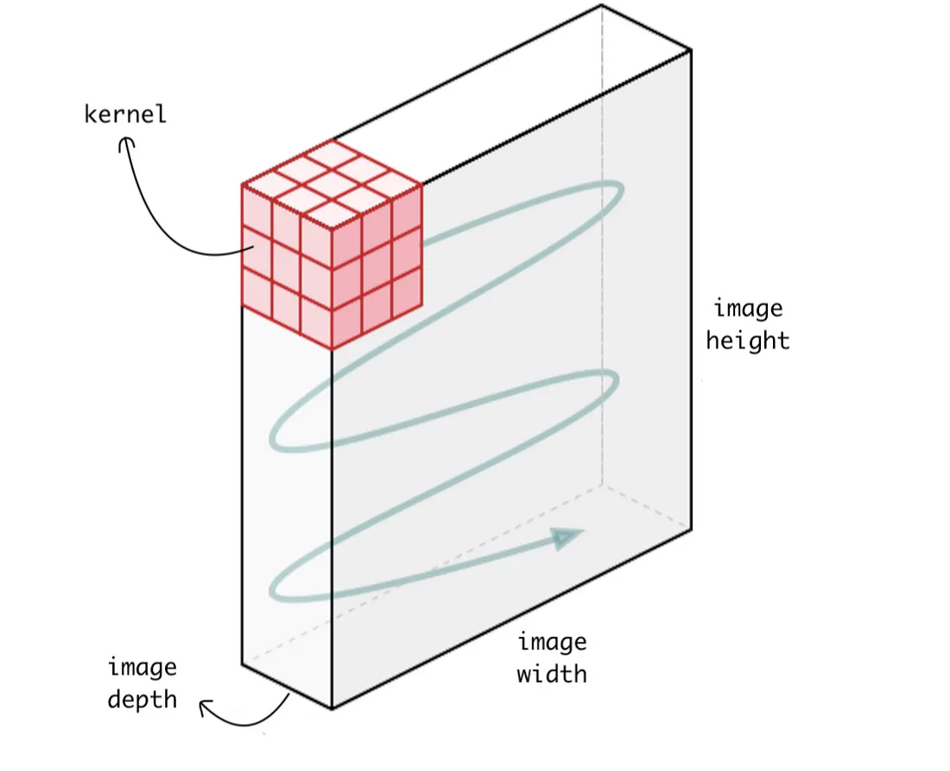
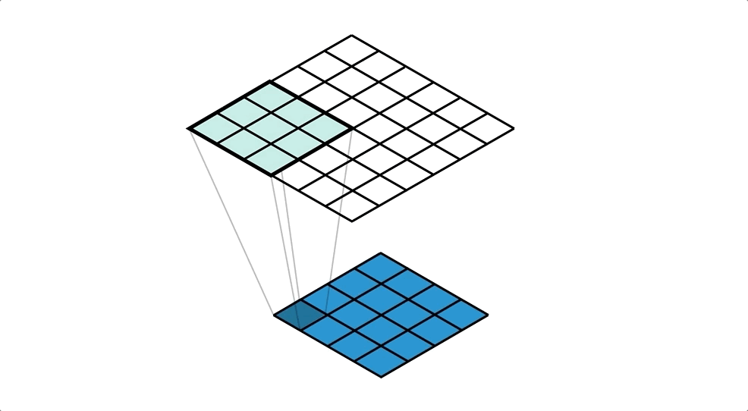
Kernel - square matix: 3x3, 5x5,7x7

Slide 11
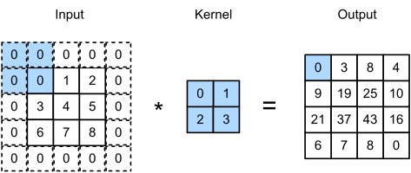
Kernel - padding

Slide 12
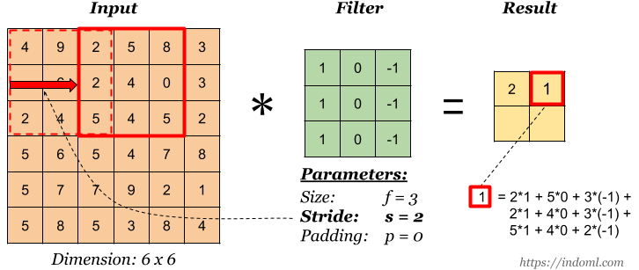
Kernel - stride

Slide 13
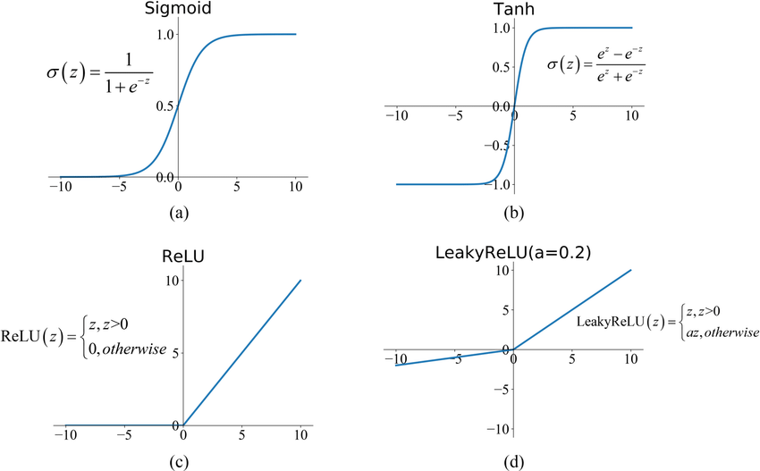
Activation layer
ReLU
LeakyReLu
Sigmoid
Hyperbolic tangent (tahn)

Slide 14
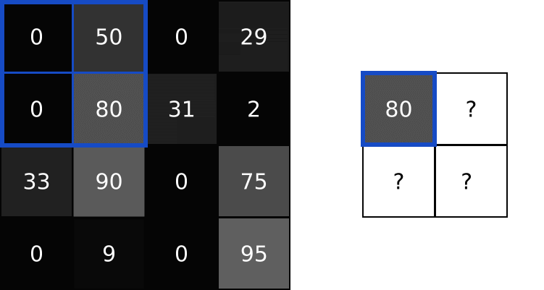
Pooling layer
Types
Max Pooling
Average Pooling
Params:
Pool size (default: 2x2)
Stride (default: same as pool size)
padding
Functions:
Preventing overfitting
Dimensionality reduction
Max Pooling

Slide 15

Flatten
Converts tensor to 1D vector – feature vector
„Bridge” between convolutional and dense layers

Slide 16
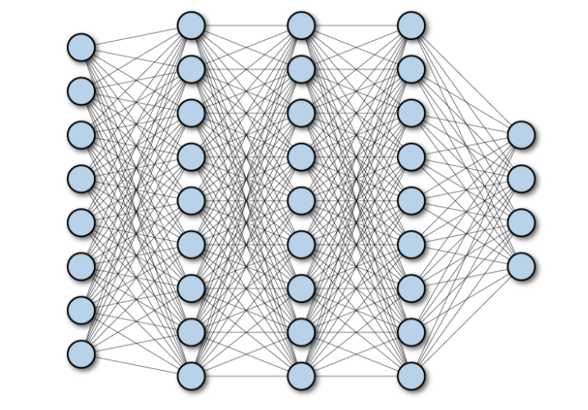
Fully Connected
Dense layer
Requires 1D vector input
Classification

Slide 17
Questions?

Slide 18


